Slide 1
Python Tkinter Database
Session 26

Slide 2
Objectives
Connecting database with Tkinter

Slide 3
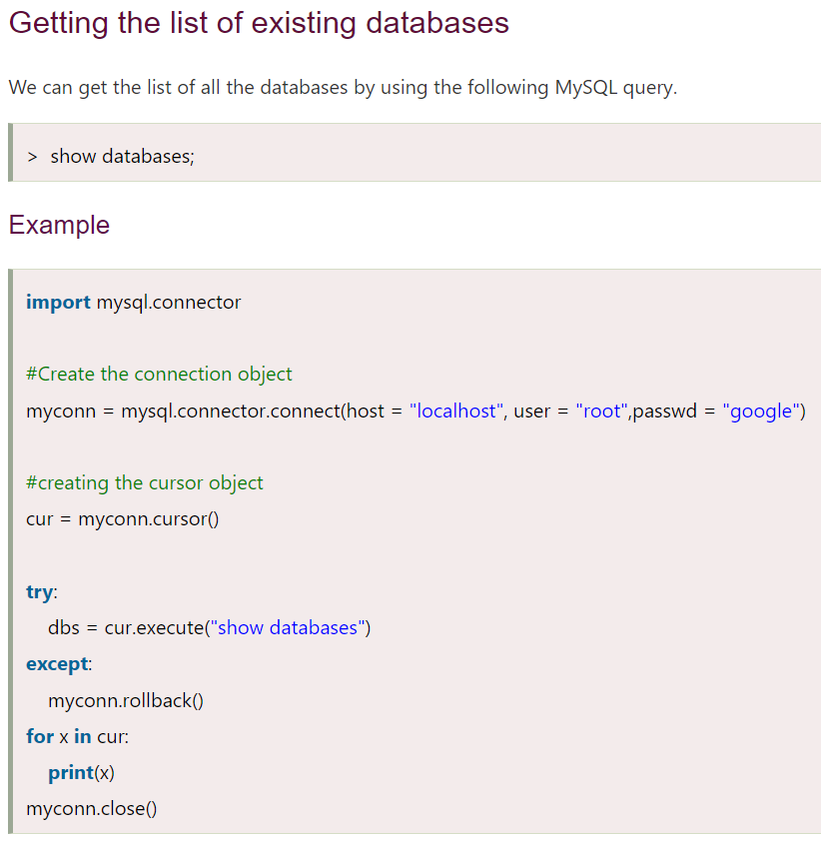
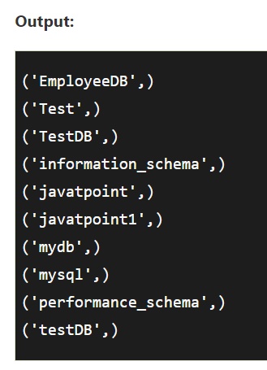
Creating new databases

Slide 4
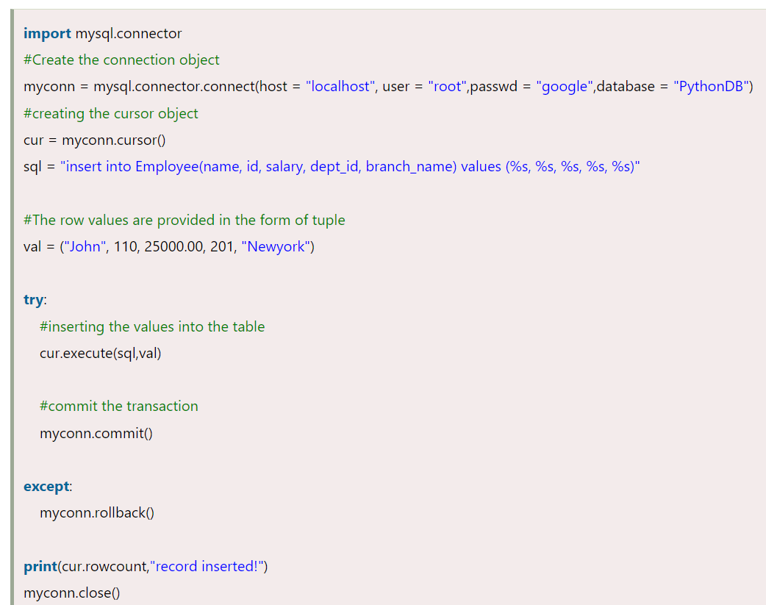
Insert Operation

Slide 5
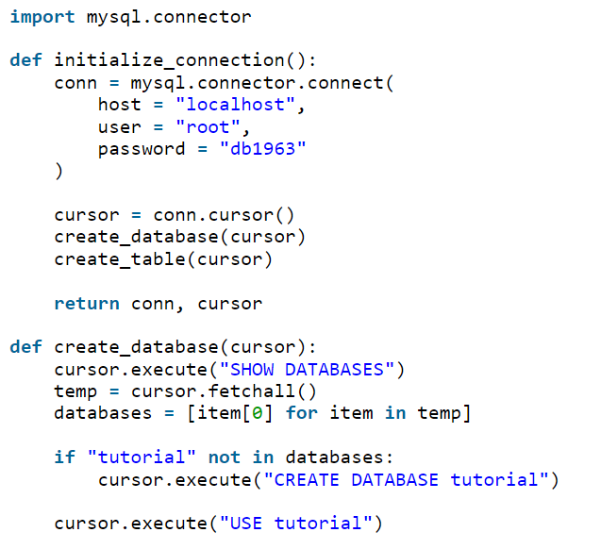
Tkinter connect to MySQL

Slide 6
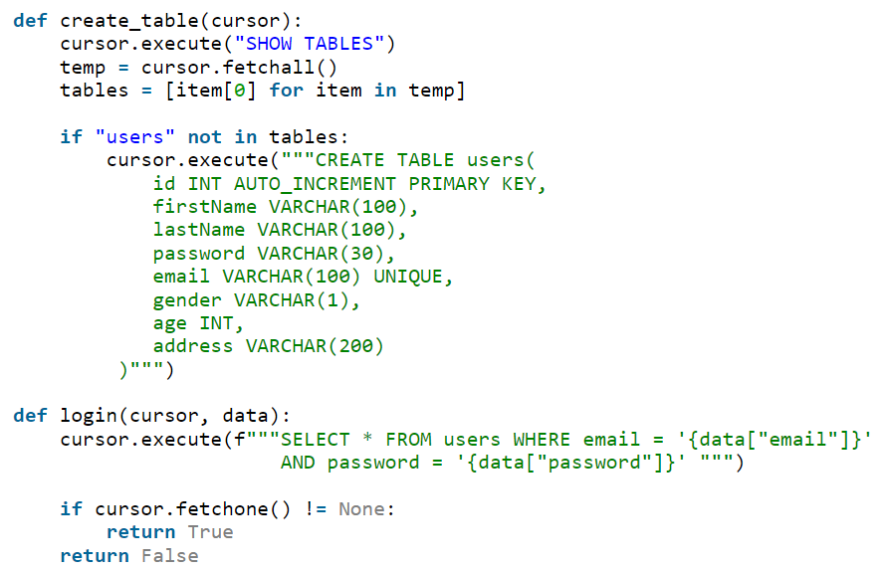
Tkinter connect to MySQL

Slide 7
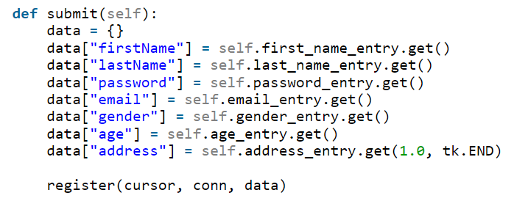
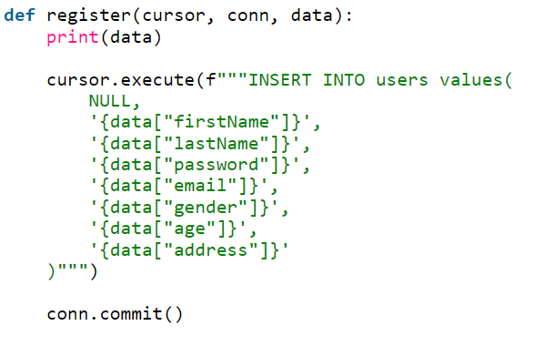
Tkinter connect to MySQL

Slide 8
Summary
Connecting database with Tkinter

